Slide 1
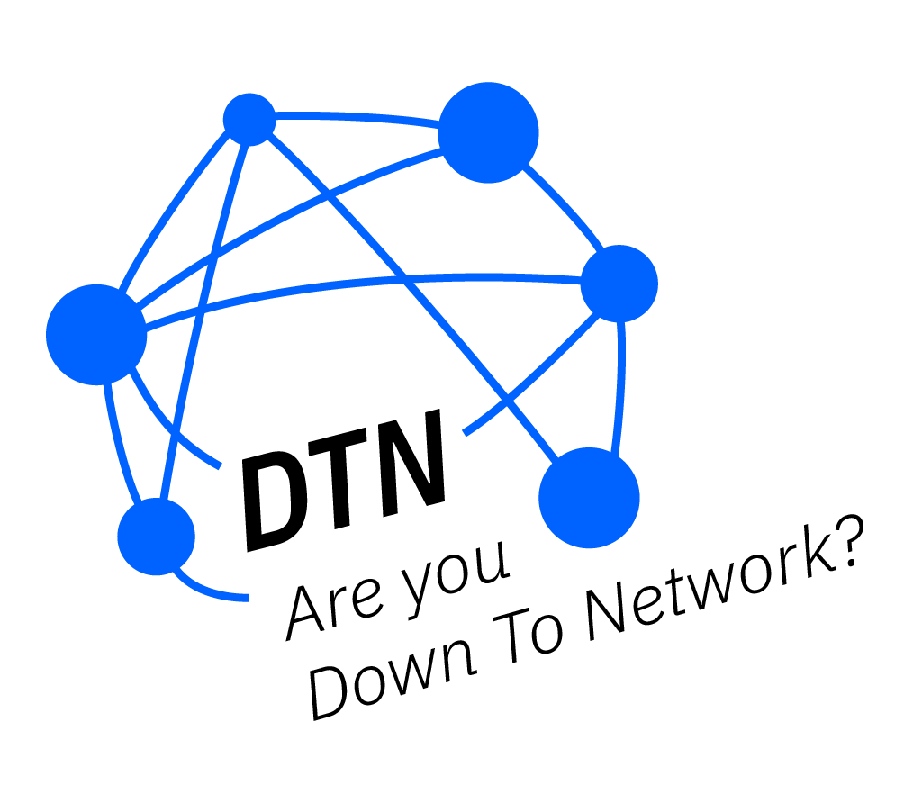
Team Fantastic Four
Nick Adamou, Diana Bank, Julia Lauer, Edward Lovely

Slide 2
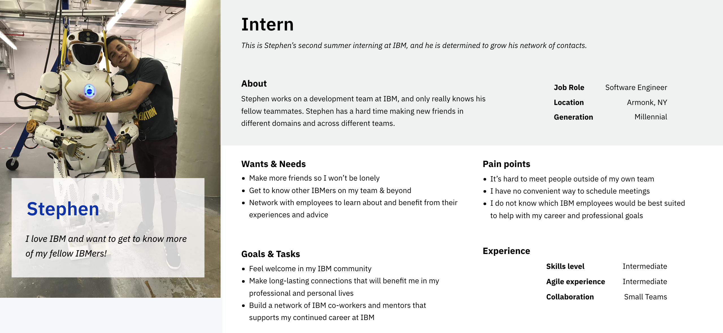

Slide 3
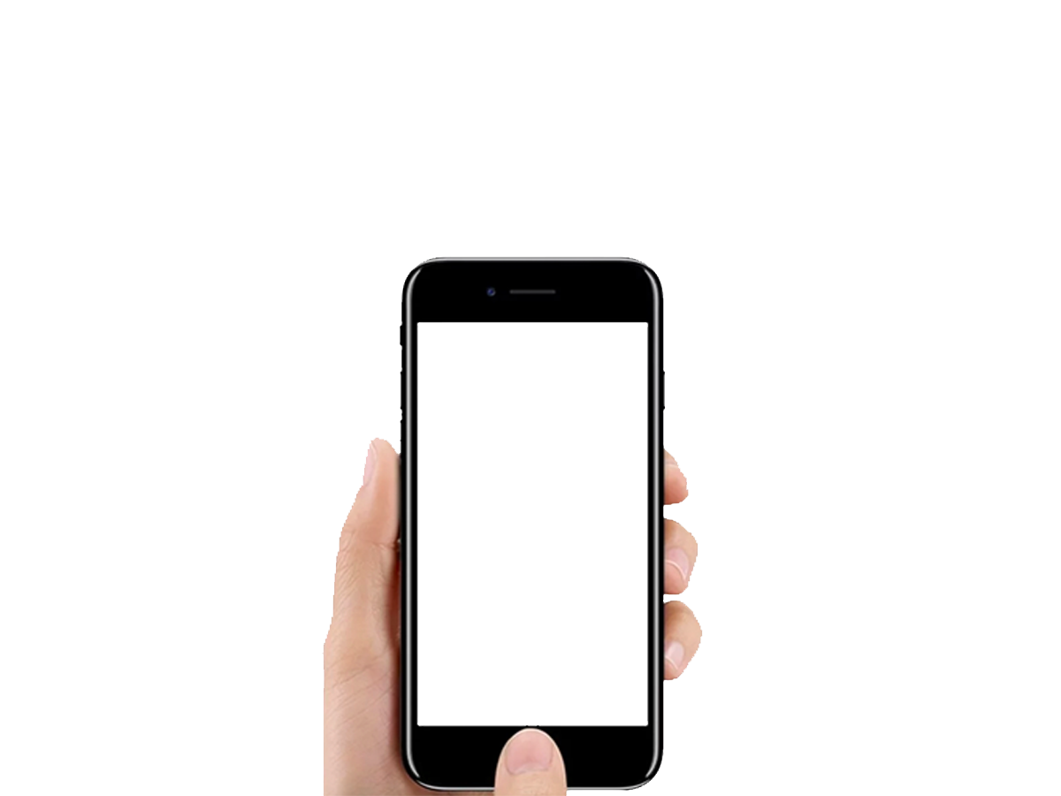
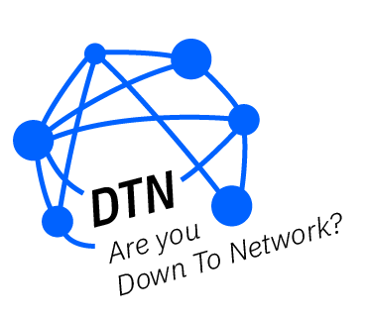

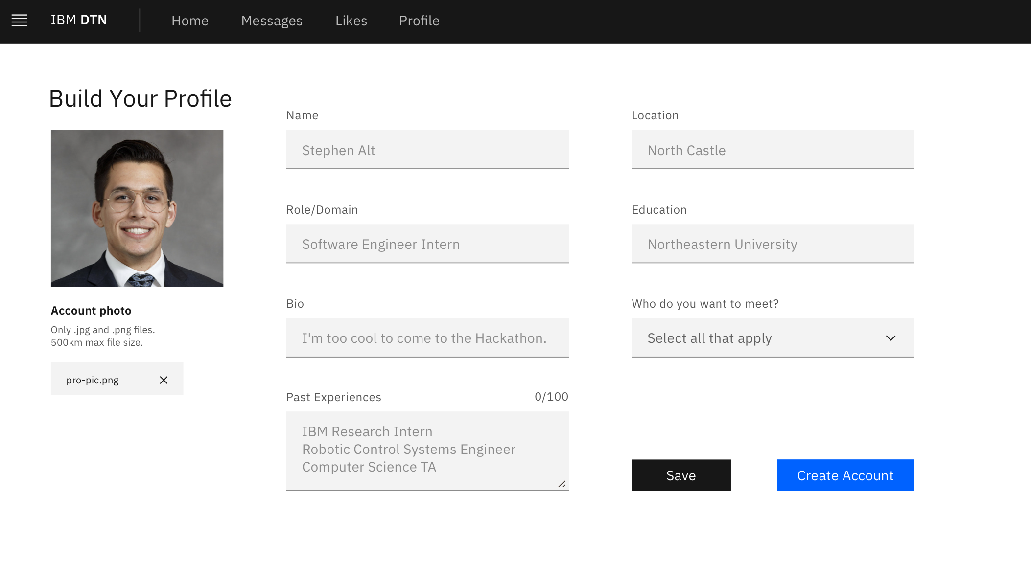
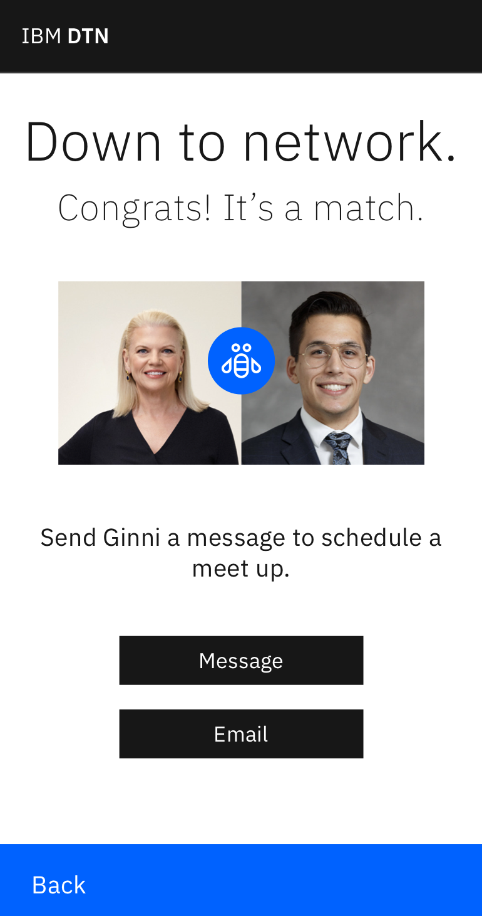

Slide 4
Demo

Slide 5
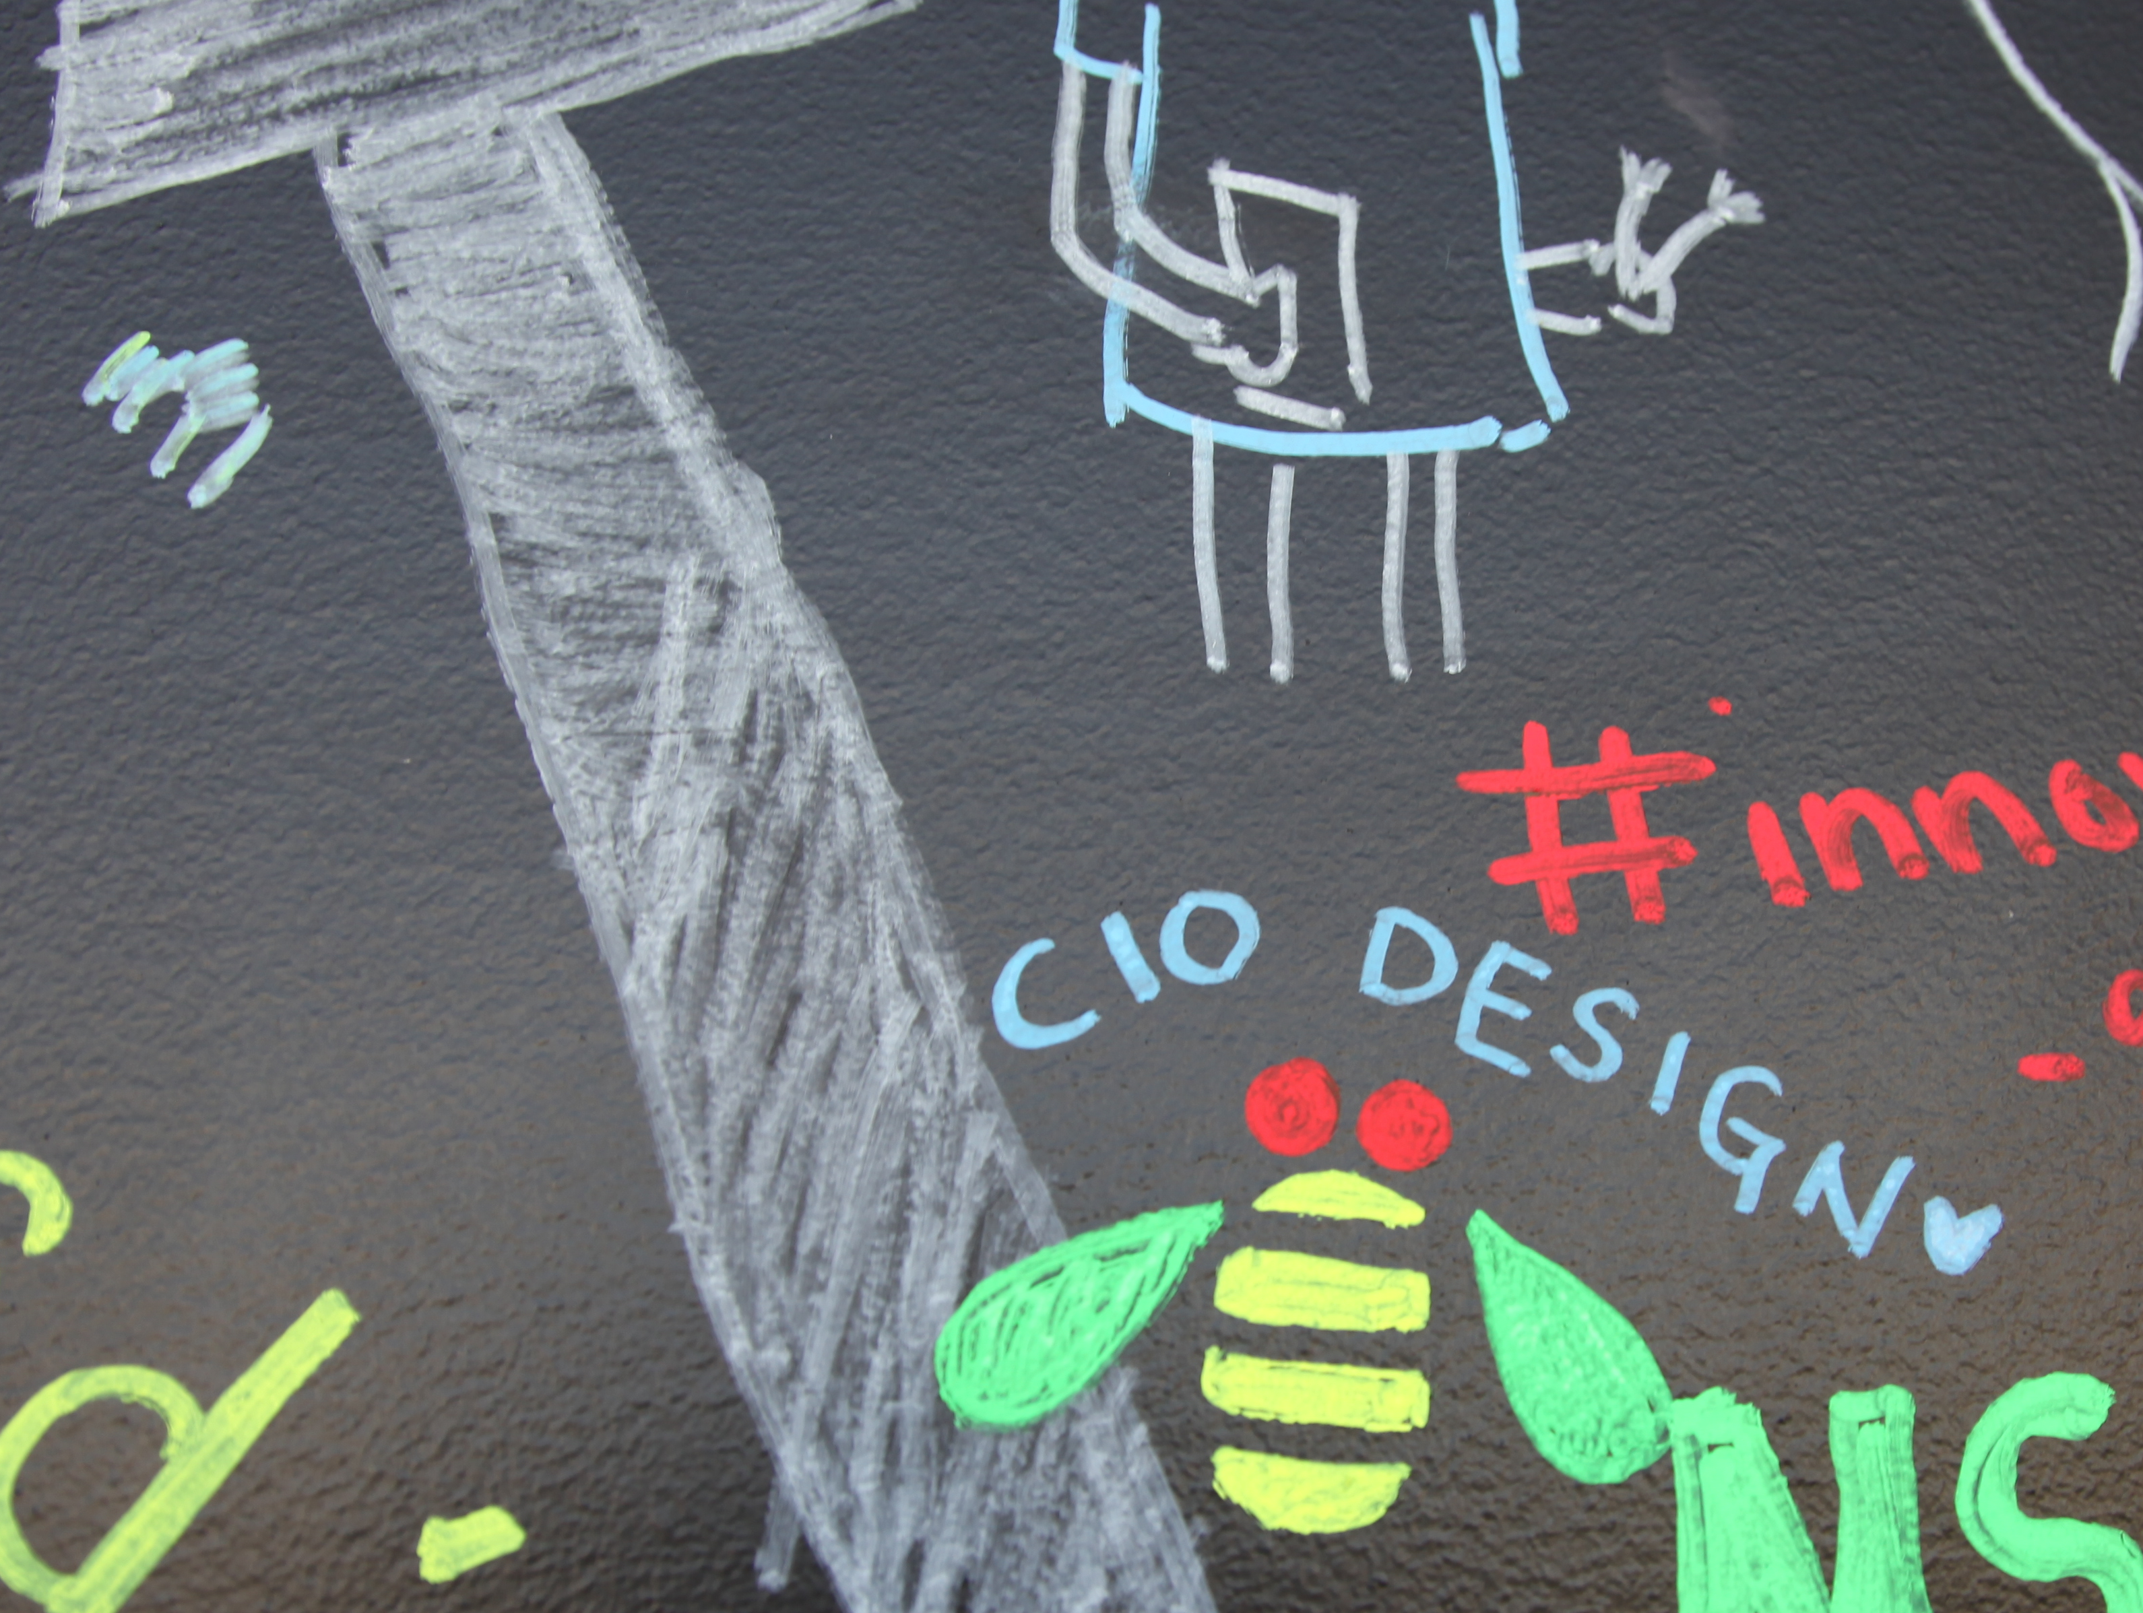
Technologies
Build
Design
React
React Context API
React Router
Firebase
Travis
Surge
DotENV
Carbon Design System
Sketch / Abstract
Invision

Slide 6
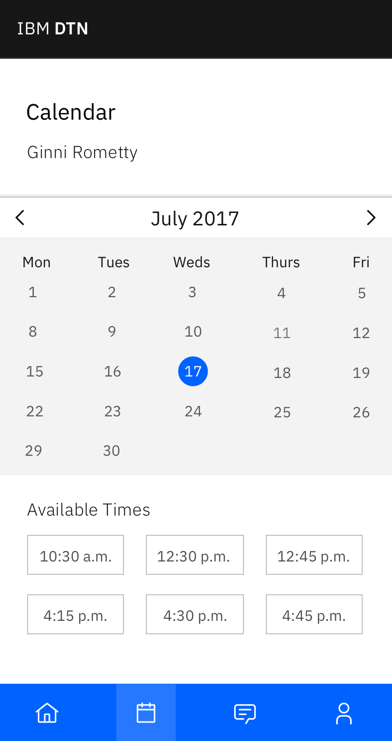
Future Features
Implementing Watson & machine learning to match users
Building an algorithm to match users based on multi-select preferences
Integration with w3, BluePages, and/or LinkedIn to simplify account creation flow
Calendar functionality to schedule meetings & send invitations within the application

Slide 7
Are you DTN?

